Slide 1
Publication Trends in the Race of World Class Status : The Case of Two Fields in a Taiwanese University Chuing Prudence Chou (周祝瑛) , National Chengchi University (台灣政治大學), Taiwan
WCCES, 2016, Beijing, China
Augut 22-26, 2016

Slide 2
Overview
In order to promote international-competitiveness and visibility, many Asian higher education institutes (HEIs) have strived for “world-class” universities.
Leading universities in East Asia have often favored faculty publishing in the international –indexed journals such as：
Science Citation Index (SCI),
the Social Science Citation Index (SSCI) or
others as major performance criteria for faculty.

Slide 3
The study aims to analyze how higher education policies have affected faculty publication profile in two departments of a national university in Taiwan since 1990s.
Journal publication was recorded in 1993, 2003 and 2013 to showcase the changing profile among each individual faculty member.
In-depth interviews were conducted among senior faculty to gain insight of the ranking impact in the last two decades.

Slide 4
Research Findings
The study concludes that the forces of globalization and ranking have affected scholars differently depending on their field of study.
The phenomenon of “publish or perish” or the “SSCI Syndrome” has played a major role in the academic reward system in Taiwan higher education.

Slide 5
What is ‘World Class’?
Publication of research in certain selected journals
Predominantly English-medium
Acceptance requires research appealing to a small number of editors
Decreasing local relevancy in research publication

Slide 6
Why ‘World Class’?
Globalization
Internationalisation
Government preference for Neo-liberal, market-based solutions
Rankings as both goal and measure (World-Class Research University Project, 2003; ‘5-year, NT$50bn’ plan).
Research output is the key

Slide 7
In the name of being as standardized and objective as possible to avoid academic bias accusations
University Quality Assurance, used as benchmark for budget allocation
Monitor the publication records among individual faculty member
New hiring practices
6-year probation
Performance and evaluation systems

Slide 8
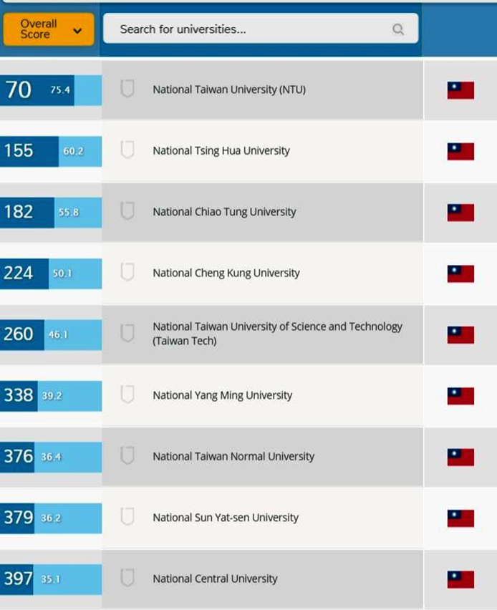
Short-term outcomes
Selected universities gained in international reputation.
Research publications rose by over 56% between 2008 and 2013 (World of Science, 2014).
Academic impact rankings showed no improvement (US still dominated.)

Slide 9
Variations： different disciplines have a different publication rate
Education:
Faculty increasingly have quantitative backgrounds.
Papers on educational psychology, science education and educational technology boost research output.
Ethnography:
Interdisciplinary – difficulty in placing articles.
Requirement for long periods of field work.

Slide 10
Publication Trends by Department
More English papers in Dept of Education after 2003.
Ethnography faculty continued publishing primarily in Chinese after 2003 .
Faculty with quantitative backgrounds published more than those with qualitative backgrounds.

Slide 11
Hiring and Promotion
Probation and evaluation systems rely heavily on research journal publications.
Promotion rates within these departments showed correlation with journal publication rates.
Faculty hired under post-2001 terms (6-year probation) tend to prioritize journal publication.

Slide 12
Trends in publication
Year | Ethnography* | Education*
1993 | 0.78 | 1.48
2003 | 0.78 | 1.67
2013 | 1.3 | 4.17
*Average number of papers published per faculty member per year.

Slide 13
Important Findings…
journal publication is number one academic task.
Rank promotion heavily depends on publication in SSCI, SCI, TSSCI.
Teaching and ‘public intellectual’ roles are less important.
Creates a ‘winner takes all’ environment amongst colleagues.
Education’s SSCI-relevant research output comes from a small number of staff.
Research topics are geared to appeal to journal editors, not be locally-relevant.
Ethnography’s low publication rate and mainly-Chinese medium make them less vulnerable to pressure.

Slide 14
This paper contains preliminary findings as part of the “Measuring Up: The Intended and Unintended Consequencesof Global Competition and Metrics on Local Scholarship” project.
For further information, please refer to Special Issue of
Higher Education Policy (2016, winter).

Slide 15
email: iaezcpc@gmail.com
Website: http://www3.nccu.edu.tw/~iaezcpc/renew_j_index.html
Recent publication:
Taiwan Education at the Crossroad (2012).
The SSCI Syndrome in Higher Education (2014)
Chinese Education Models in a Global Age (2016)

Slide 16
Thanks for your attention. 感恩與感謝！

